Slide 1
NC Department of Health and Human Services
Accessing Available HB630 Reports in Client Services Data Warehouse (CSDW)
January 11, 2019

Slide 2
Today’s Objectives
How to get access to CSDW via eIRAAF
CSDW Basic Navigation
Review data used to calculate 4 of 5 Child Support Performance Measures using CSDW
Review data used to calculate 1 of 5 Child Support Performance Measures using XPTR/XNET
Review data used to calculate one FNS Performance Measure (FNS4 – Establishing Program Integrity Claims Timely) using CSDW
Review data used to calculate all 4 Work First Performances Measures using CSDW

Slide 3
Introduction to Client Services Data Warehouse (CSDW)
How To Get Access
Basic Navigation

Slide 4
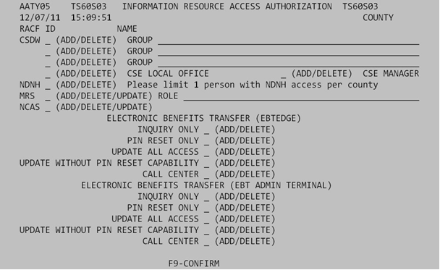
Requesting Access to CSDW
Access to CSDW must be requested by your security officer via the eIRAAF.
When requesting access, please be sure to specify the programs in which you need access to on the “GROUP” line.

Slide 5
If you need or do not have access to the reports in today’s presentation, please have your security officer to submit an eIRAAF and indicate that you need access to the “PM-REM” group.
This access will allow you to view queries for the following programs:
Adult Services, Child Support, Food & Nutrition Services, Energy and Work First
If access is needed to view Child Care and Child Welfare reports, in addition to requesting the PM-REM group, the security officer will need to also indicate Child Welfare and Child Care on the group line as well.
Quick Notes Regarding Access

Slide 6
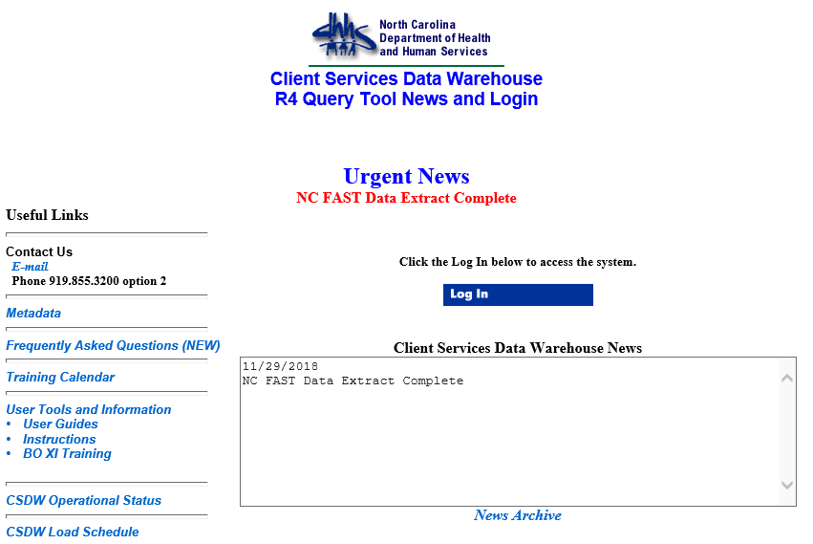
Logging Into CSDW
Open Internet Explorer or other appropriate web browser.
Note: Not all versions of all web browsers support the Data Warehouse.
Type in the web site address: https://csdwportal.dhhs.state.nc.us/csdwlogin/
The Client Services Data Warehouse Log In Page will display.
Click the Log In box.
The Welcome to BusinessObjects page will display.

Slide 7
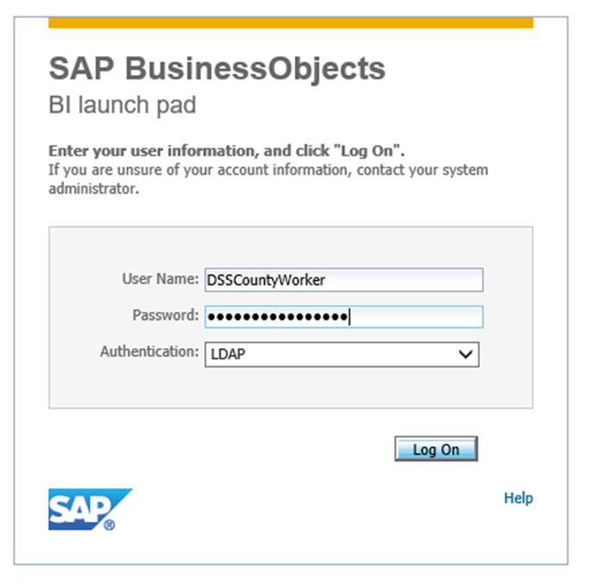
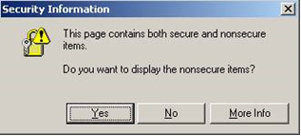
Enter your Username and Password.
Your user name and password are your NCID user name and password.
Authentication should be LDAP.
Click Log On.
NOTE: You may see this message. Click “Yes.”

Slide 8
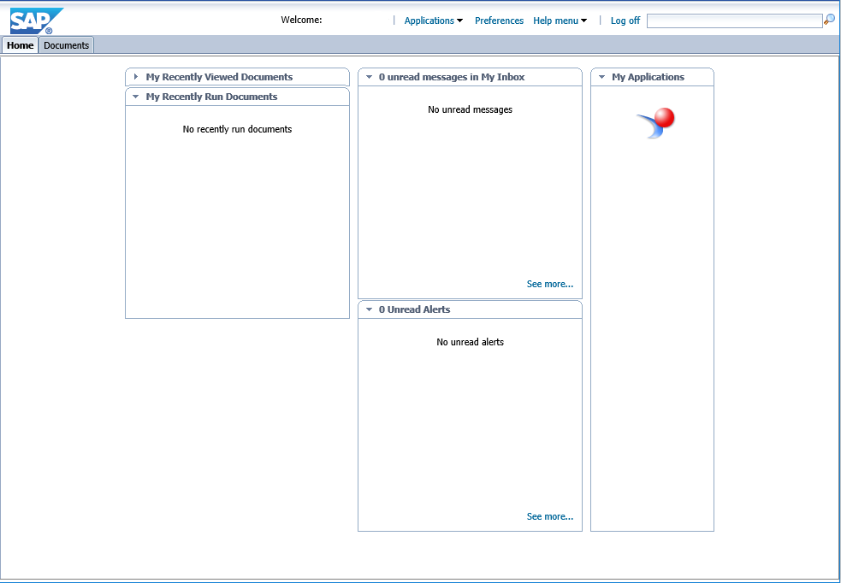
The Main Page will display.
Note: From this point forward your screens may not look exactly like the pictures in this guide. That is due to the fact that different users have different program areas they may view within the Data Warehouse and all users have their own way of organizing their personal queries.

Slide 9
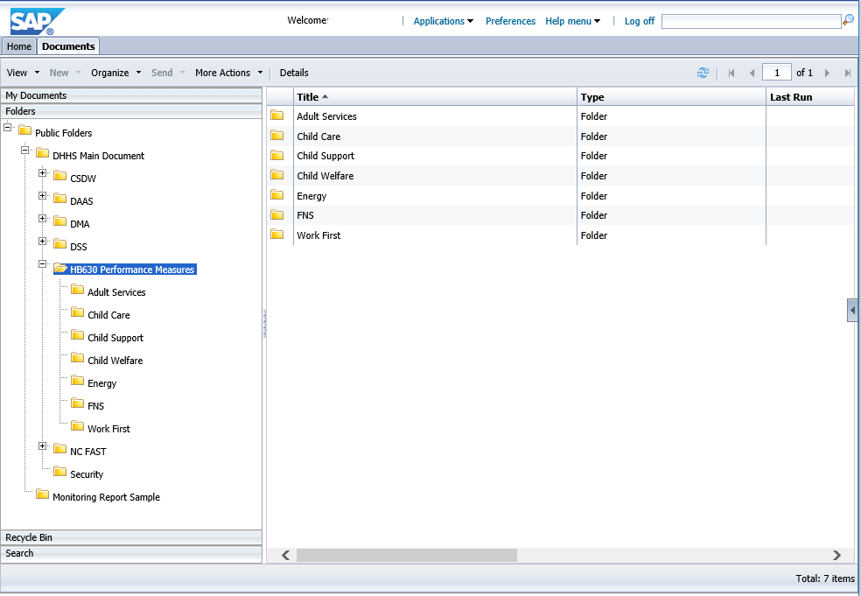
Navigation to HB630 Reports

Slide 10
Quick Notes
Much like Microsoft Word and other programs, there are often multiple ways to do the same thing in the Client Services Data Warehouse. All possible alternatives are not explored within this session.
For more information on how to use CSDW, please refer to the attached document titled, “Client Services Data Warehouse Basic Training.”

Slide 11
STATE PERFORMANCE MEASURES
North Carolina Child Support Services

Slide 12
WHAT ARE THE STATE PERFORMANCE MEASURES
There are five performance measures used for NC Child Support Services. Those measures are listed below:
Percentage of Paternities Established
Percentage of Cases Under Order
Percentage of Current Support Paid
Percentage of Cases With Payment to Arrears
Total Collections
With the exception of Total Collections, the performance measures are calculated using the OCSE-157 Report.
(NOTE: Total Collections is determined using the XPTR Report, IVD COLLECTIONS REPORT)

Slide 13
The OCSE-157 is used by all states to report statistical and some financial information regarding outcomes for their Child Support Services program to the Federal Department of Health and Human Services. The information is then used to provide an annual report to Congress on the program.
NC Child Support Services uses this report to establish State and local office goals, to review incentives and evaluate training needs across the state.
WHAT IS THE OCSE-157 REPORT

Slide 14
HOW TO REVIEW THE PERFORMANCE MEASURES
Child Support Services uses Client Services Data Warehouse to provide the performance measures for four performance indicators:
  Percentage of Paternities Established
  Percentage of Cases Under Order
  Percentage of Current Support Paid
  Percentage of Cases With Payment to Arrears
These can be reviewed in a single report titled:
INCENTIVE REPORT BY COUNTY NAME WITH STATEWIDE TOTALS
The fifth measure, Total Collections, is found in XPTR (XTND) and is titled:
IVD COLLECTIONS REPORT
(/DHR/FKK/F237)

Slide 15
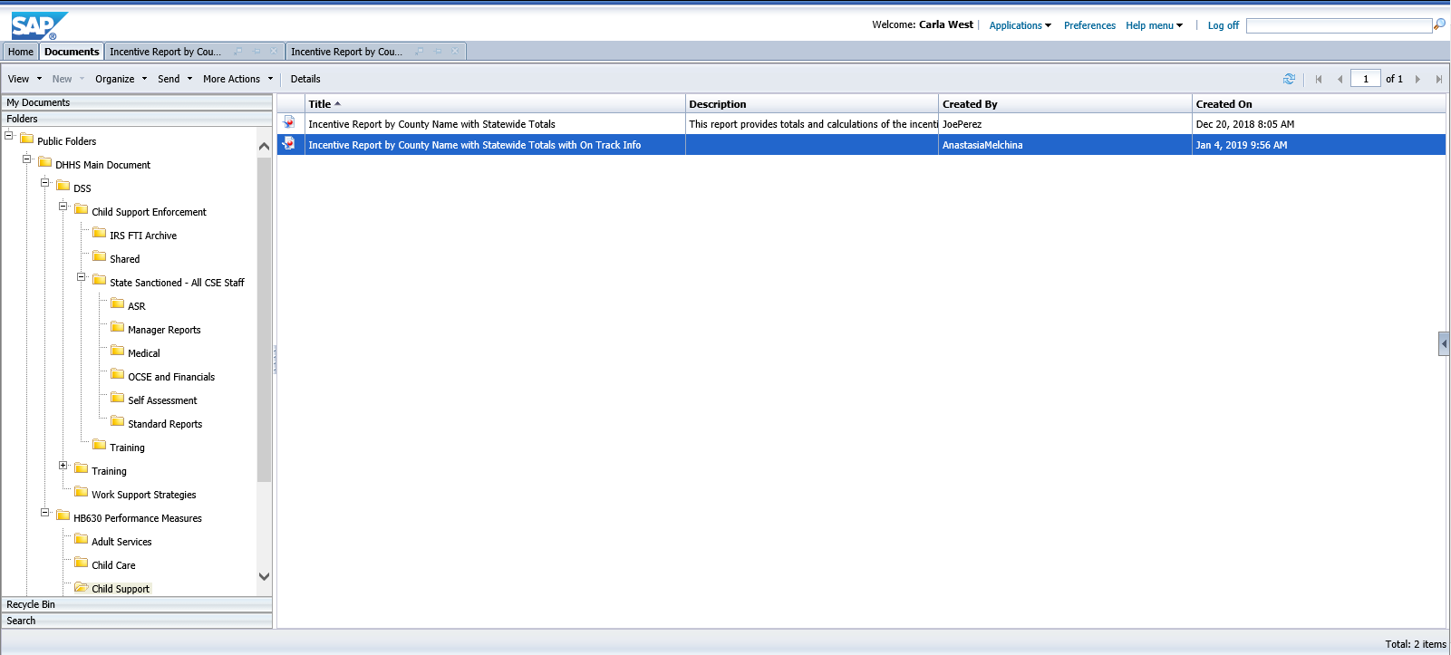
Folders>Public Folders>DHHS Main Document>HB630 Performance Measures>Child Support
REPORT NAME: Incentive Report by County Name with Statewide Totals

Slide 16
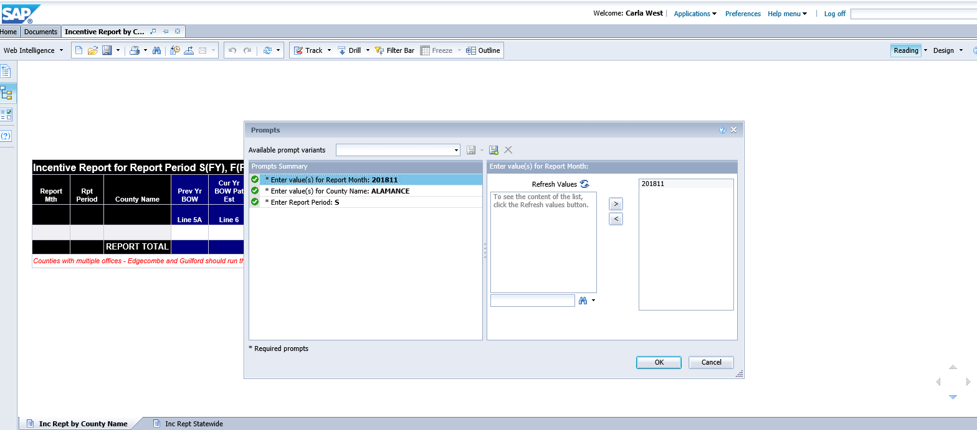
After clicking the report to run, a prompt box comes up.
When running this report in data warehouse it is important to remember to use S (State Fiscal Year) for the reporting period in order to obtain accurate results.
You may need to “Refresh Values” to see a list of available selections.

Slide 17
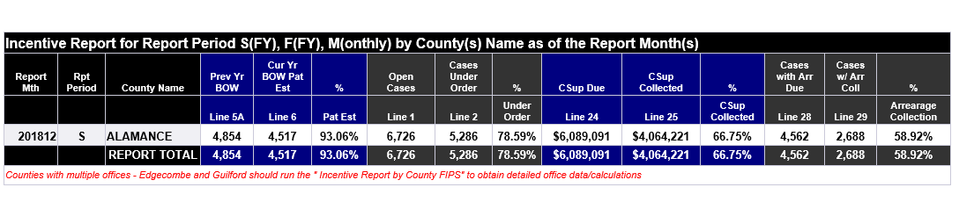
  INCENTIVE REPORT BY COUNTY NAME WITH STATEWIDE TOTALS

Slide 18
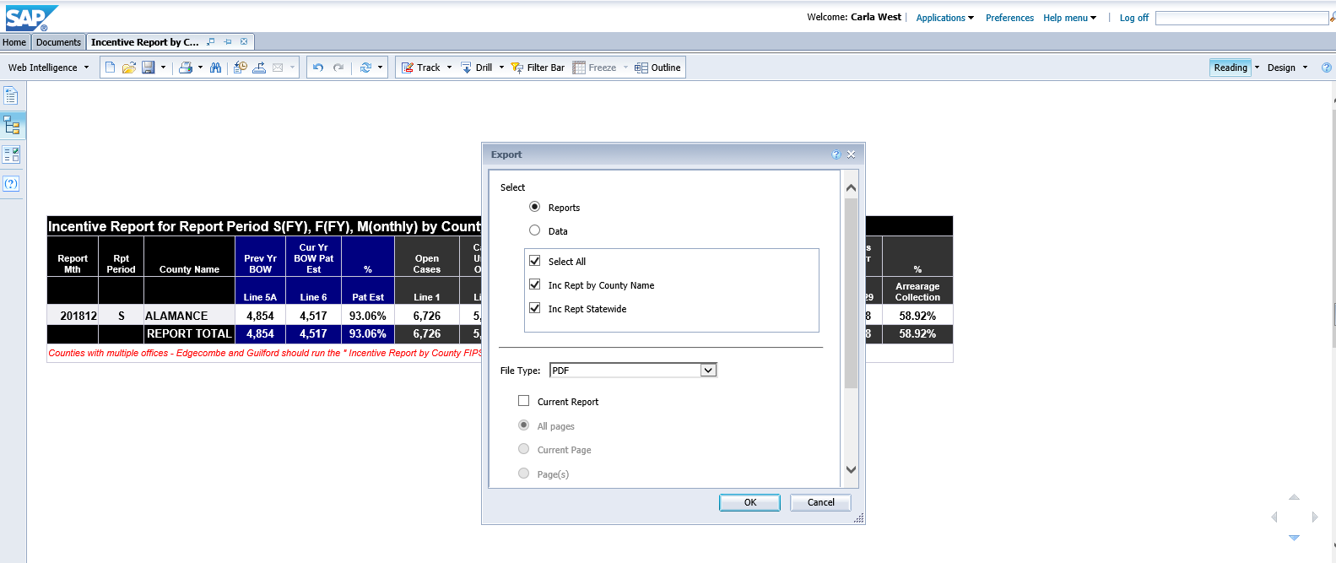
To download or save the report…
Click “Export” to export to your computer in PDF, Excel, or CSV format
Choose your file type (PDF, Excel, or CSV)
Then click OK

Slide 19
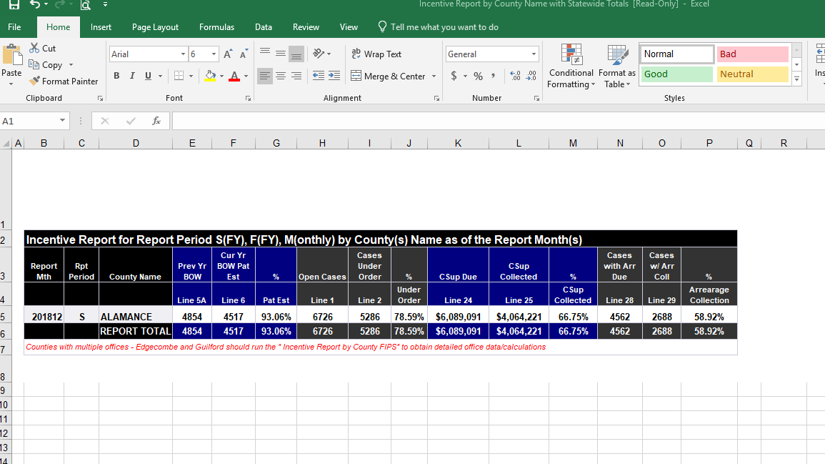

Slide 20
CSS State Performance Measures at a Glance
Performance Measure Calculations

Slide 21
CS 1 – The county will achieve its given annual percentage of paternities established for children born our of wedlock
Line 6 OCSE 157
Children BOW in IV‑D Cases Open During or at the End of the Fiscal Year With Paternity Established or Acknowledged
Report Mth | Rpt Period | County Name | Prev Yr BOW | Cur Yr BOW Pat Est | %
 |  |  | Line 5A | Line 6 | Pat Est
201812 | S | ALAMANCE | 4854 | 4517 | 93.06%
 |  | REPORT TOTAL | 4854 | 4517 | 93.06%
Line 5a OCSE 157
Children in IV‑D Cases Open at the End of the Prior Fiscal Year Who Were Born Out-of-Wedlock

Slide 22
CS 2 – The county will achieve its given annual percentage of child support cases that are under an order
Line 2 OCSE 157
Cases Open at the End of the Fiscal Year With Support Orders Established
Report Mth | Rpt Period | County Name | Open Cases | Cases Under Order | %
 |  |  | Line 1 | Line 2 | Under Order
201812 | S | ALAMANCE | 6726 | 5286 | 78.59%
 |  | REPORT TOTAL | 6726 | 5286 | 78.59%
Line 1 OCSE 157
Cases Open at the End of the Fiscal Year

Slide 23
CS 3 – The county will achieve its given annual percentage of current child support paid
Line 25 OCSE 157
Total Amount of Support Distributed as Current Support During the Fiscal Year
Report Mth | Rpt Period | County Name | CSup Due | CSup Collected | %
 |  |  | Line 24 | Line 25 | CSup Collected
201812 | S | ALAMANCE | $6,089,091 | $4,064,221 | 66.75%
 |  | REPORT TOTAL | $6,089,091 | $4,064,221 | 66.75%
Line 24 OCSE 157
Total Amount of Current Support Due for the Fiscal Year

Slide 24
CS 4 – The county will achieve its given annual percentage of cases that received a payment towards arrears
Line 29 OCSE 157
Cases Paying Toward Arrearages During the Fiscal Year
Report Mth | Rpt Period | County Name | Cases with Arr Due | Cases w/ Arr Coll | %
 |  |  | Line 28 | Line 29 | Arrearage Collection
201812 | S | ALAMANCE | 4562 | 2688 | 58.92%
 |  | REPORT TOTAL | 4562 | 2688 | 58.92%
Line 28 OCSE 157
Cases with Arrears Due During the Fiscal Year

Slide 25
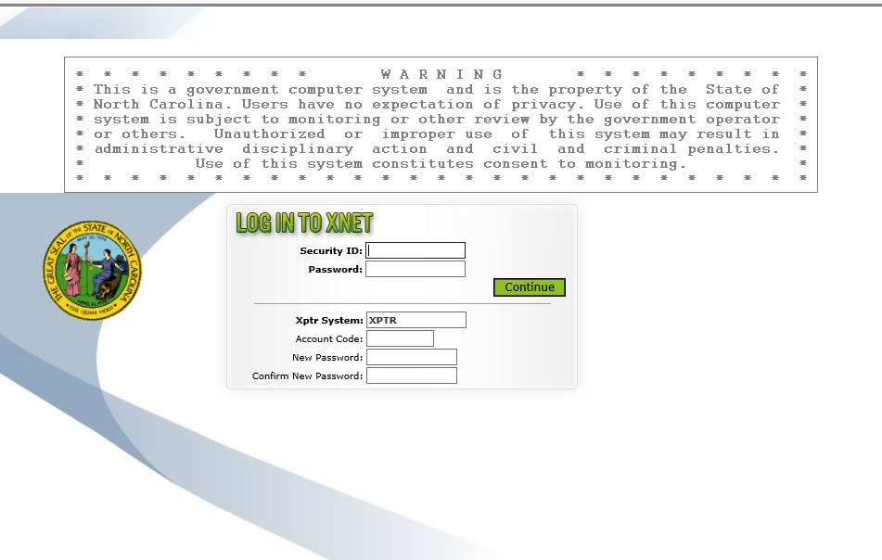
CS 5 – The county will meet its annual goal of total child support collections
https://scca.its.state.nc.us/xnet/CSPLOG.htm
SECURITY ID = RACF ID
PASSWORD = RACF ID PASSWORD
XPTR SYSTEM = CSSX
ACCOUNT CODE = DHRFKY

Slide 26
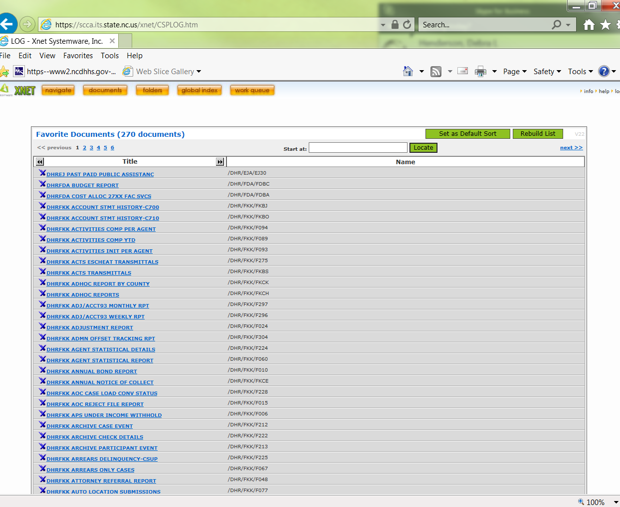
To quickly locate the IVD COLLECTIONS REPORT, click NAVIGATE

Slide 27
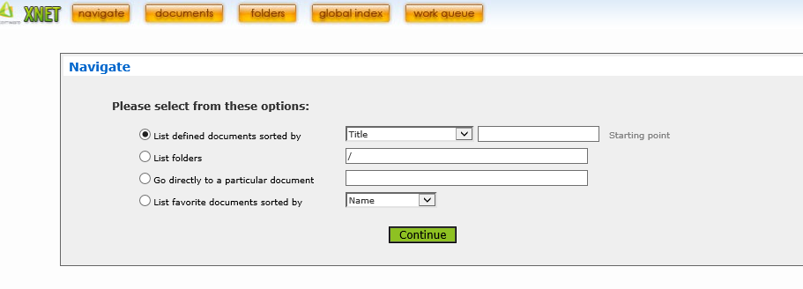
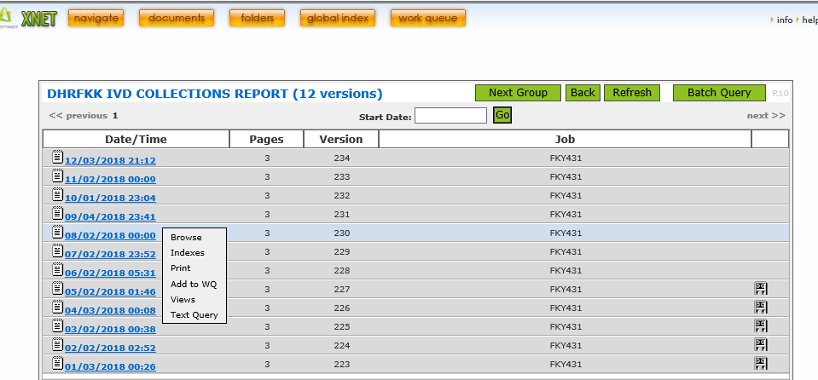
Click GO DIRECTLY TO A PARTICULAR DOCUMENT then type in: /DHR/FKK/F237
Click CONTINUE
To review the most recent version of the report, click the first report.

Slide 28
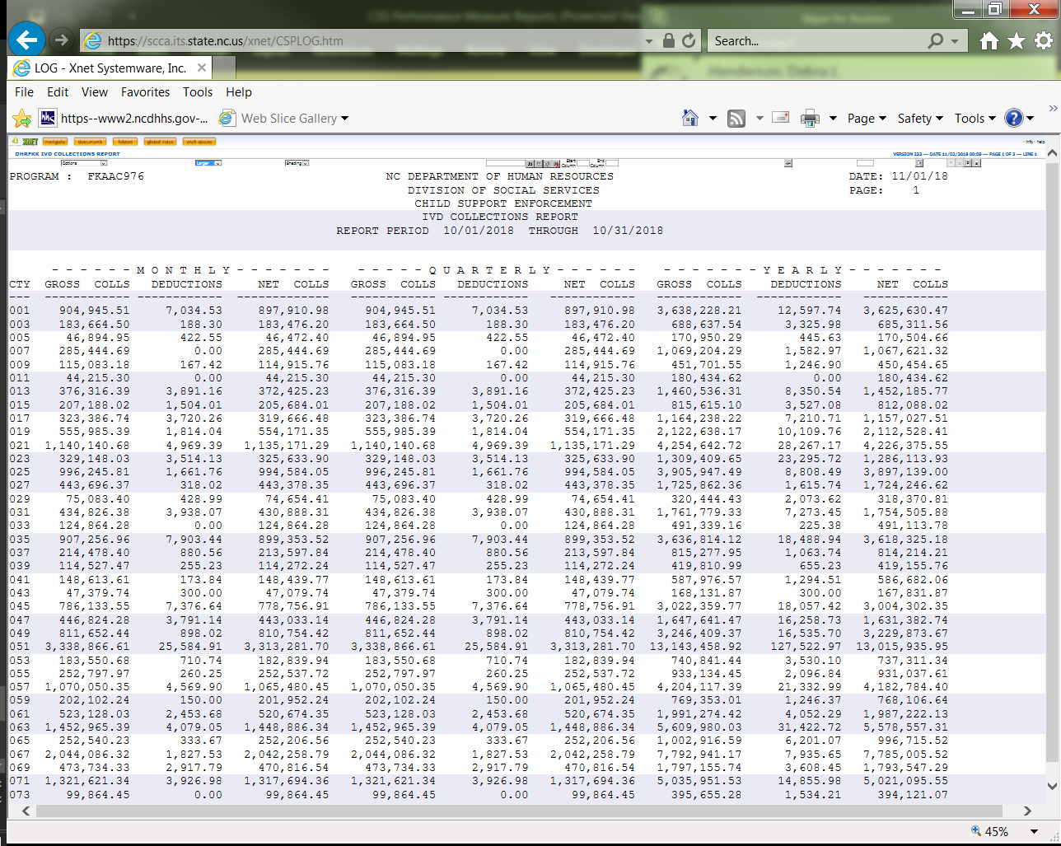
YEARLY NET COLLS provides the figure for TOTAL COLLECTIONS
NOTE: The county is listed by number. A list of county numbers is provided in the handout.

Slide 29
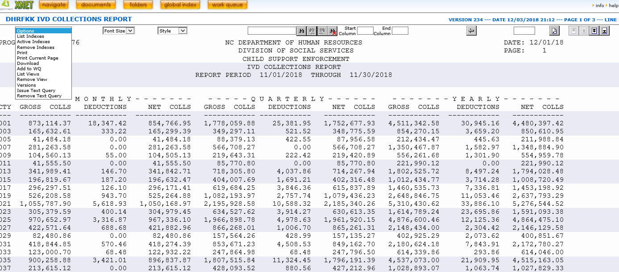
To download and save, click Options. See instructions for more details.

Slide 30
Open the most recent XPTR file IV-D DISBURSEMENTS in XTND.
Select FILE, SAVE AS and save the file as IVD COLLECTIONS REPORT MMYYYY.txt (Remember the location!)
Open WORD.
Locate the file just saved.
Once the file opens, notice that the first page is typically blank. Delete this page.
Change the font of the document by taking the following steps:
  CTRL A
  CHANGE FONT TO Courier new 8pt
CHANGE page orientation to LANDSCAPE
Save file.
Instructions on How to Download
IV-D Collections Reports

Slide 31
Are you on track?
Paternity Establishment, Cases Under Order, Current Support, Arrears
Where you were at this time last year
+
Any increase or decrease in goal (if applicable)
On Track Goal for Current Month
Compared to where you are this year
Greater than or equal to …… Yes
Less than …… No

Slide 32
Are you on track?
Total Collections
Each month represents 1/12th of the total goal
MONTH | % OF COLLECTION |  | MONTH | % OF COLLECTION
July | 8.33% |  | January | 58.33%
August | 16.67% |  | February | 66.67%
September | 25% |  | March | 75%
October | 33.33% |  | April | 83.33%
November | 41.67% |  | May | 91.67%
December | 50% |  | June | 100%

Slide 33
QUESTIONS
If there are additional questions about the child support performance measures, please contact the designated regional child support representative for your county.

Slide 34
STATE PERFORMANCE MEASURES
North Carolina Economic & Family Services (EFS)
Available CSDW Reports ONLY
FNS4, WF1, WF2, WF3, WF4

Slide 35
WHAT ARE THE EFS PERFORMANCE MEASURES AVAILABLE IN CSDW
There are five EFS HB630 performance measure reports available via CSDW. Those measures are listed below:
FNS4 – Timely Establishment of PI Claims
WF1 – Documentation of Required Hours of All Work-Eligible Individuals
WF2 – Documentation of Required Hours of Two-Parent Families with Work Eligible Individuals
WF3 – Timely Application Processing
WF4 – Timely Recertification Processing

Slide 36
FNS4: The County will ensure that 90% of Program Integrity claims are established within 180 days of the date of discovery.
FNS Manual Section 800
Federal Requirement 7 CFR 273.18
Number of Claims Established in 180 days or less
Total Number of Claims Established During the Month

Slide 37
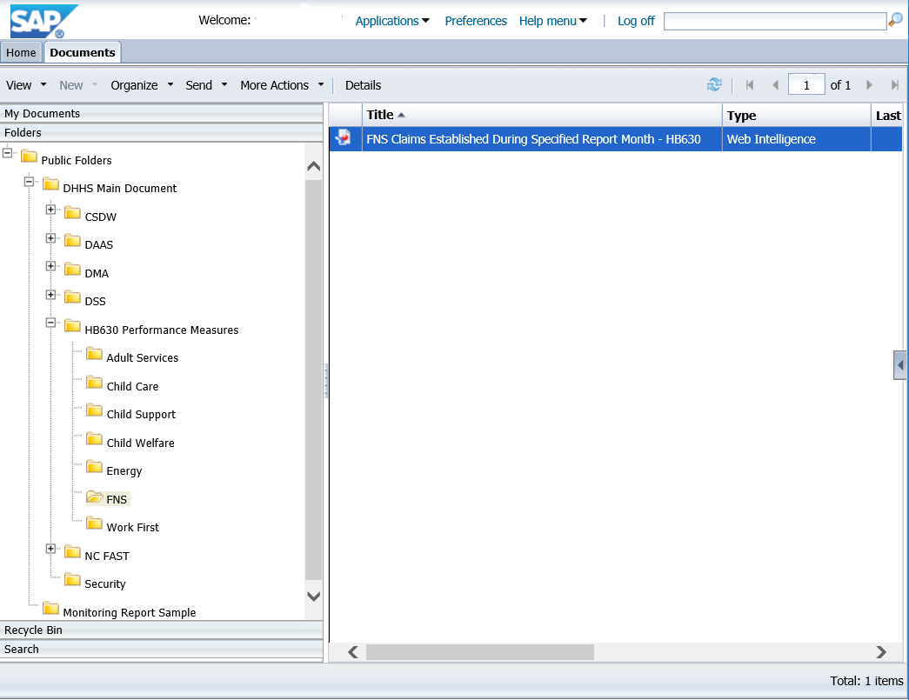
Folders>Public Folders>DHHS Main Document>HB630 Performance Measures>FNS
REPORT NAME: FNS Claims Established During Specified Report Month

Slide 38
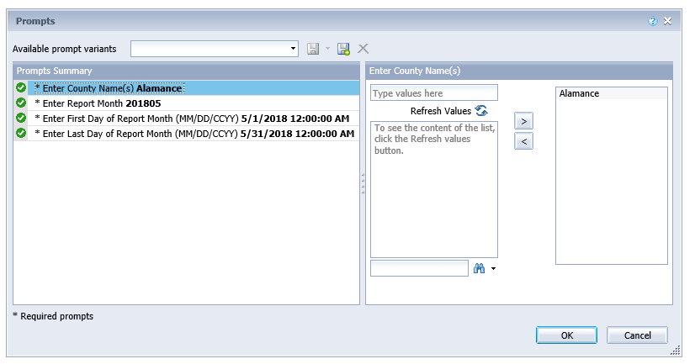
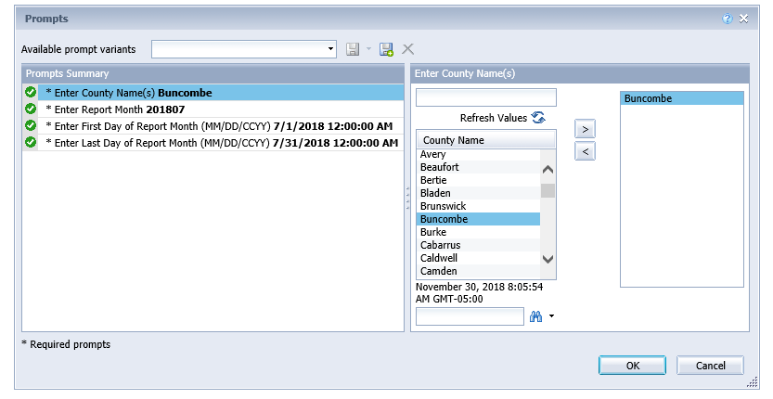
After clicking the report to run, a prompt box comes up.
You may need to “Refresh Values” to see a list of available selections.

Slide 39
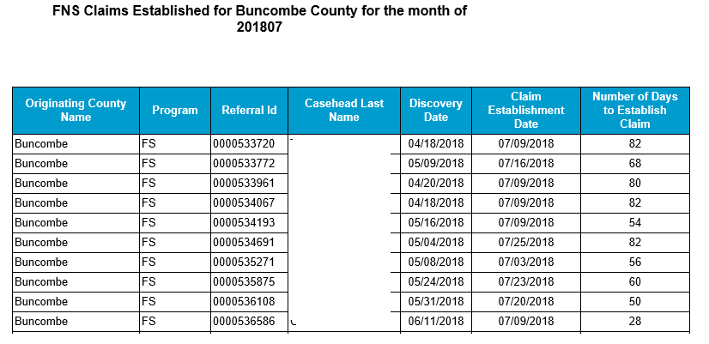
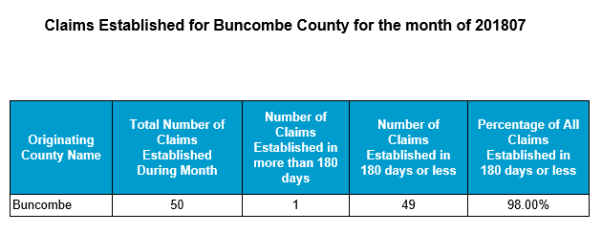
Two Tabs – Detail & Aggregate
TAB 1:
Claims Established During Specified Report Month
TAB 2:
Percent of claims established timely
Aggregate Report – Percent of claims established timely
The numerator is the total number of claims established in 180 days or less divided by the total number of claims established during the specified month. (49/50)
Detail Report – Claims Established During Specified Report Month
Shows all claims that were established in the specified month.
If they were established in 180 days or less from discovery, they are timely.
If they were established more than 180 days from discovery, they are untimely.
NOTE: Refer to Slide 18 for instructions on how to download & save the reports.

Slide 40
QUESTIONS
If there are additional questions about the FNS 4 performance measure, please contact the designated regional OST representative for your county.

Slide 41
WF 1 – The county will collect documentation from 50% of all Work First Eligible individuals that demonstrates completion of the required number of hours of federally countable work activities.
Work First Manual Section 001; Manual Section 003; TANF State Plan FFY 2016 – 2019; NC GS 108A-27.2(10); NC GS 108A-27.6(1); NC GS 108A-27.13(a); NC GS 108A-27.14(a); NC GS 108A-27.14(b)
Cases that Met their Hours
All Cases Who Received a Payment

Slide 42
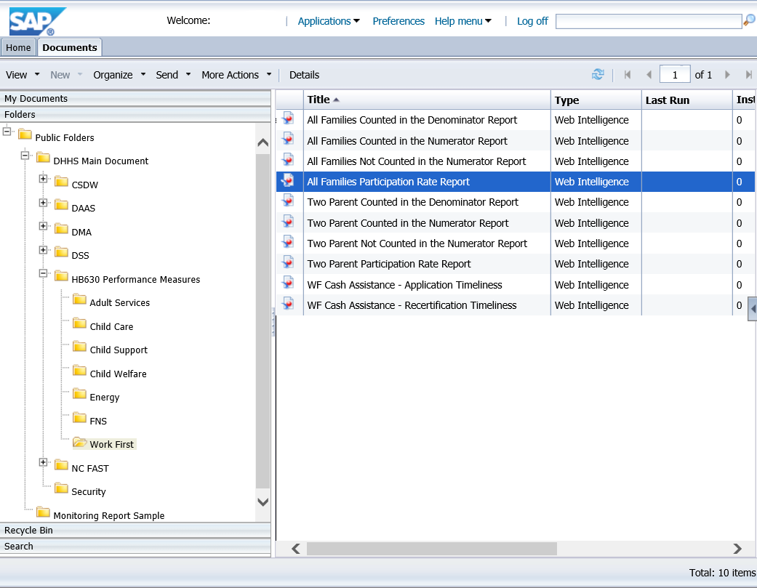
Folders>Public Folders>DHHS Main Document>HB630 Performance Measures>Work First
REPORT NAME:
All Families Participation Rate Report

Slide 43
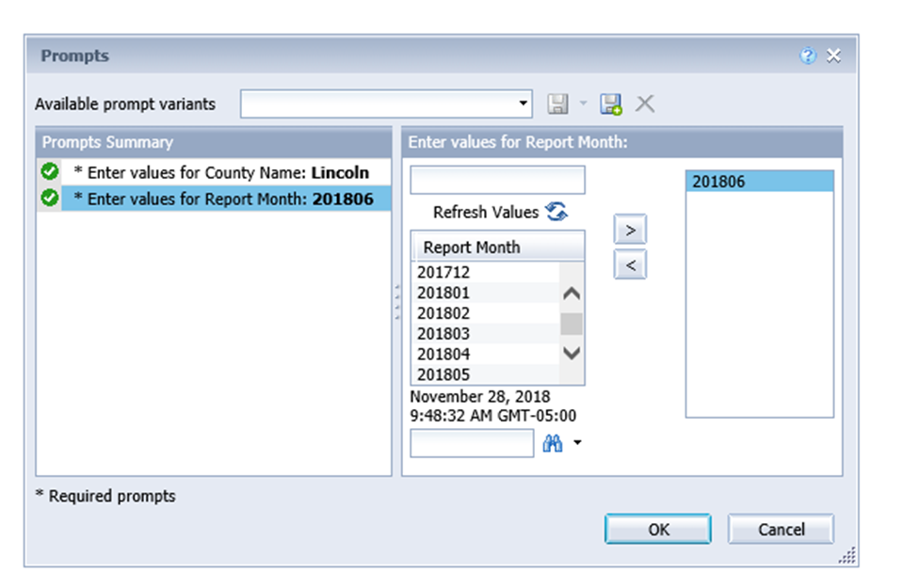
After clicking the report to run, a prompt box comes up.
You may need to “Refresh Values” to see a list of available selections.

Slide 44
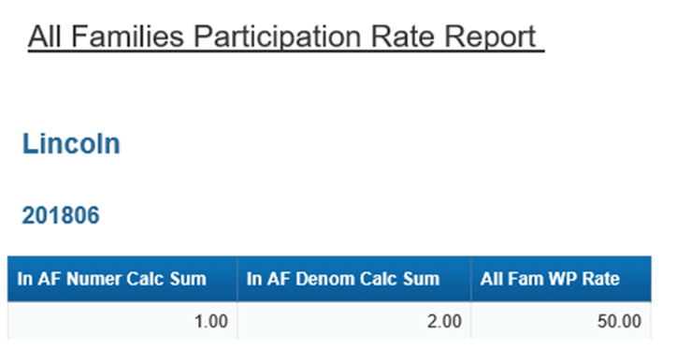
All Families Participation Rate Report
In this case, the county has a rate of 50% because they had 2 cases that received a payment, but only 1 case that met hours.

Slide 45
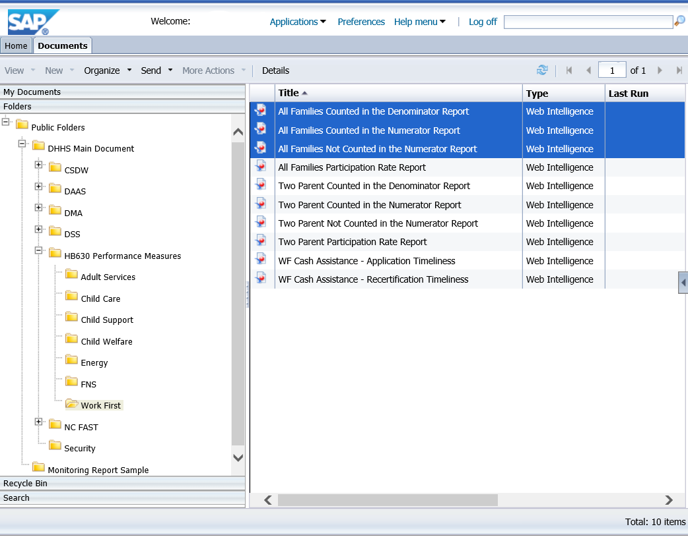
To find out what cases represent the numbers in the previous slide, there are 3 additional detailed reports that provide this information.
Folders>Public Folders>DHHS Main Document>HB630 Performance Measures>Work First
REPORT NAMES:
All Families Counted in the Denominator Report
All Families Not Counted in the Numerator Report
All Families Counted in the Numerator Report

Slide 46
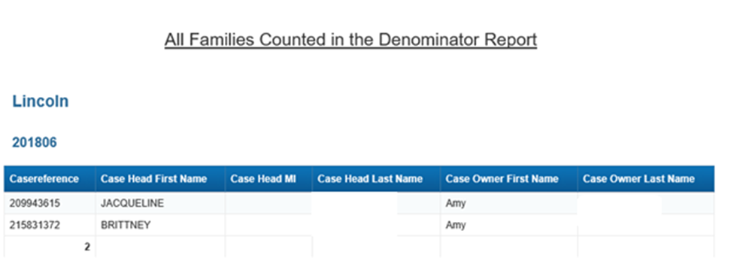
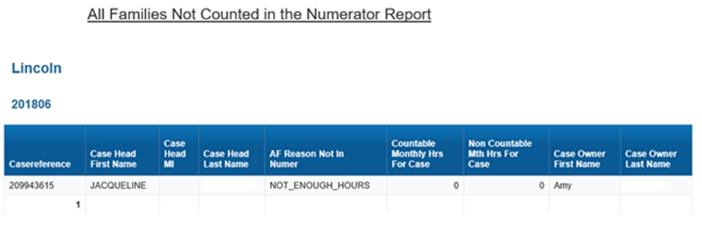
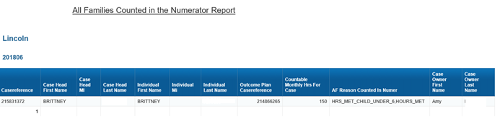
All Families Counted in the Denominator Report
All Families Not Counted in the Numerator Report
All Families Counted in the Numerator Report

Slide 47
WF2 – The County will collect documentation from 90% of two-parent families with Work Eligible individuals that verifies that the they have completed the required number of hours of federally countable work activities.
Work First Manual Section 001; Work First Manual Section 003; TANF State Plan FFY 2016 – 2019; NC GS 108A-27.2(10); NC GS 108A-27.6(1); NC GS 108A-27.13(a); NC GS 108A-27.14(a); NC GS 108A-27.14(b)
Cases that Met their Hours
All Cases Who Received a Payment

Slide 48
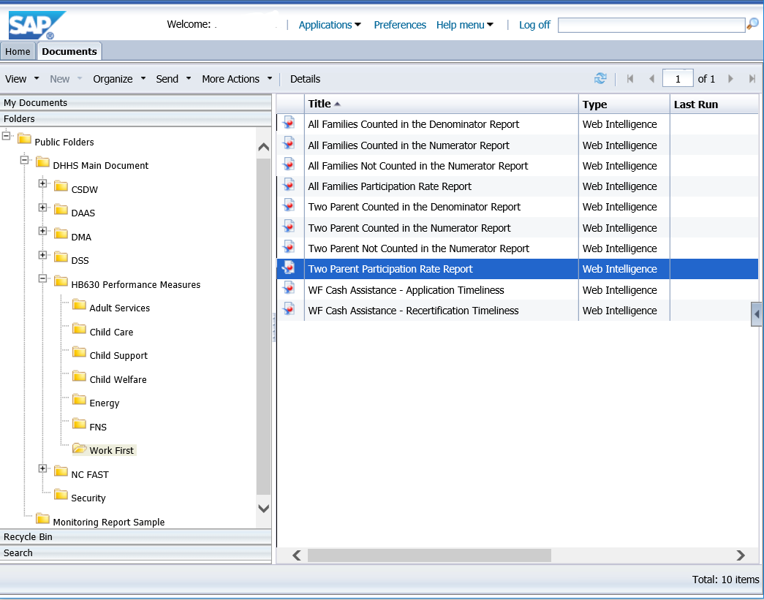
Folders>Public Folders>DHHS Main Document>HB630 Performance Measures>Work First
REPORT NAME:
Two Parent Participation Rate Report

Slide 49
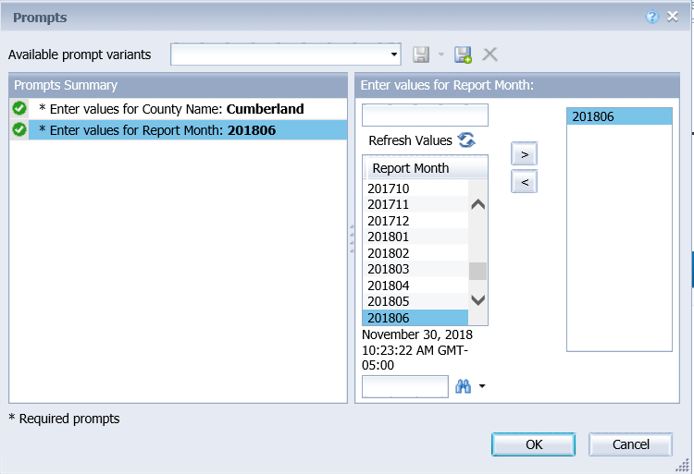
After clicking the report to run, a prompt box comes up.
You may need to “Refresh Values” to see a list of available selections.

Slide 50
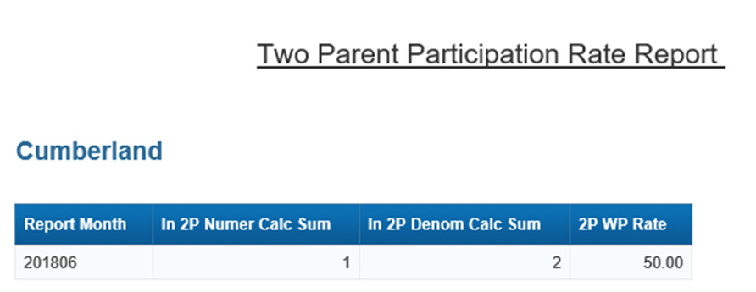
Two Parent Participation Rate Report
In this case, the county has a rate of 50% because they had 2 cases that received a payment, but only 1 who met hours.

Slide 51
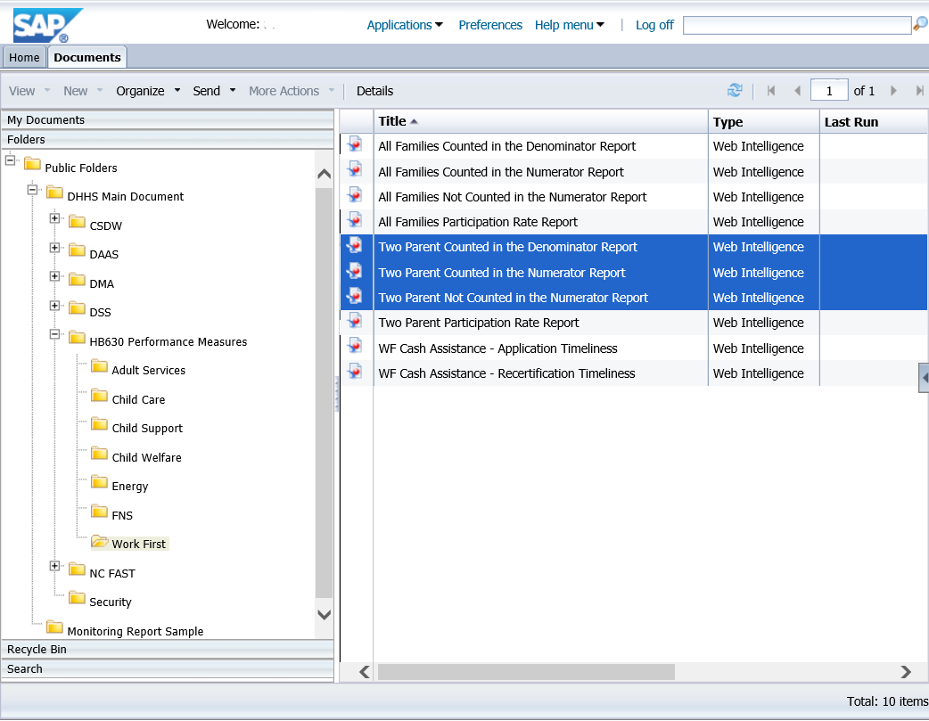
To find out what cases represent the numbers in the previous slide, there are 3 additional detailed reports that provide this information.
Folders>Public Folders>DHHS Main Document>HB630 Performance Measures>Work First
REPORT NAMES:
Two Parent Counted in the Denominator Report
Two Parent Not Counted in the Numerator Report
Two Parent Counted in the Numerator Report

Slide 52
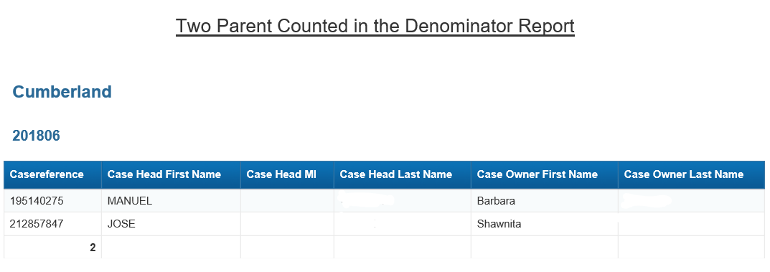
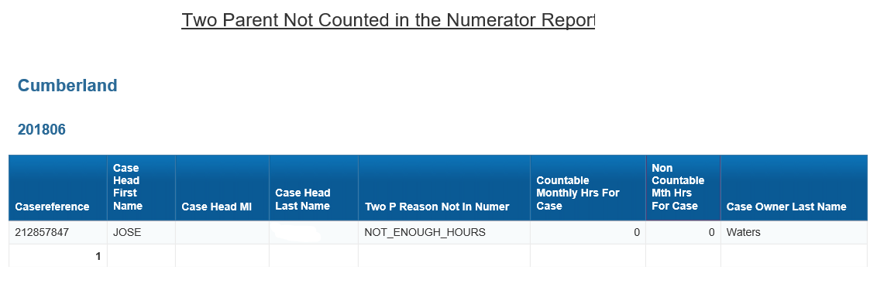
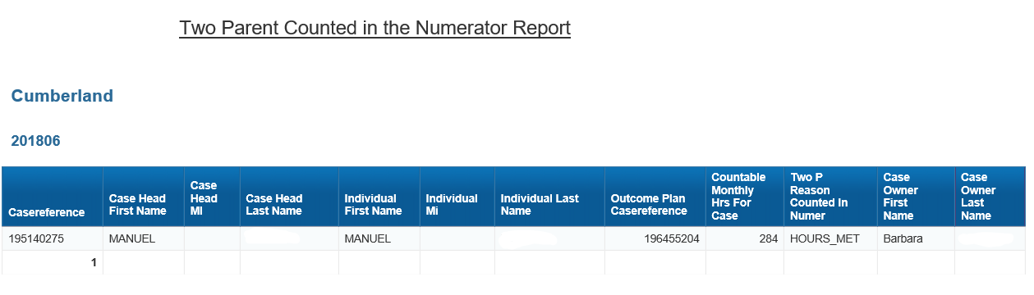
Two Parent Counted in the Denominator Report
Two Parent Not Counted in the Numerator Report
Two Parent Counted in the Numerator Report

Slide 53
WF3: The County will process 95% Work First applications within 45 days of receipt.
Work First Manual Section 104
TANF State Plan FFY 2016 - 2019
NC GS 108A-31
Total number of timely WF applications processed timely
Total number of WF applications

Slide 54
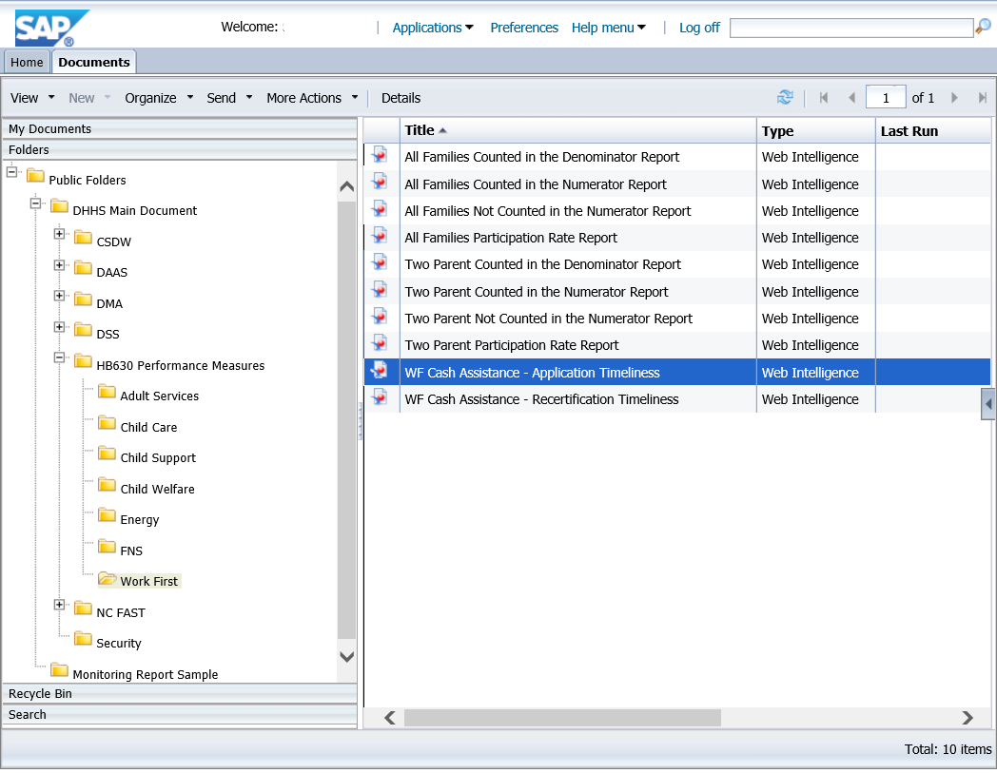
Folders>Public Folders>DHHS Main Document>HB630 Performance Measures>Work First
REPORT NAME: WF Cash Assistance – Application Timeliness

Slide 55
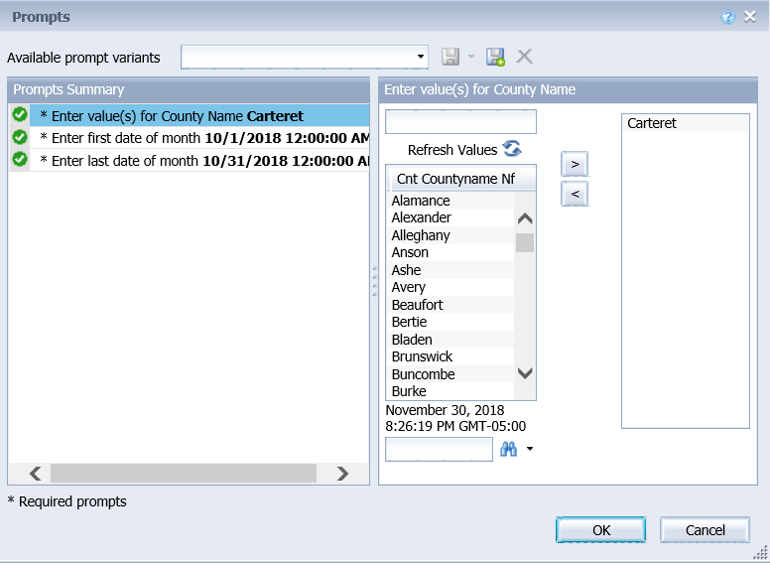
After clicking the report to run, a prompt box comes up.
You may need to “Refresh Values” to see a list of available selections.

Slide 56
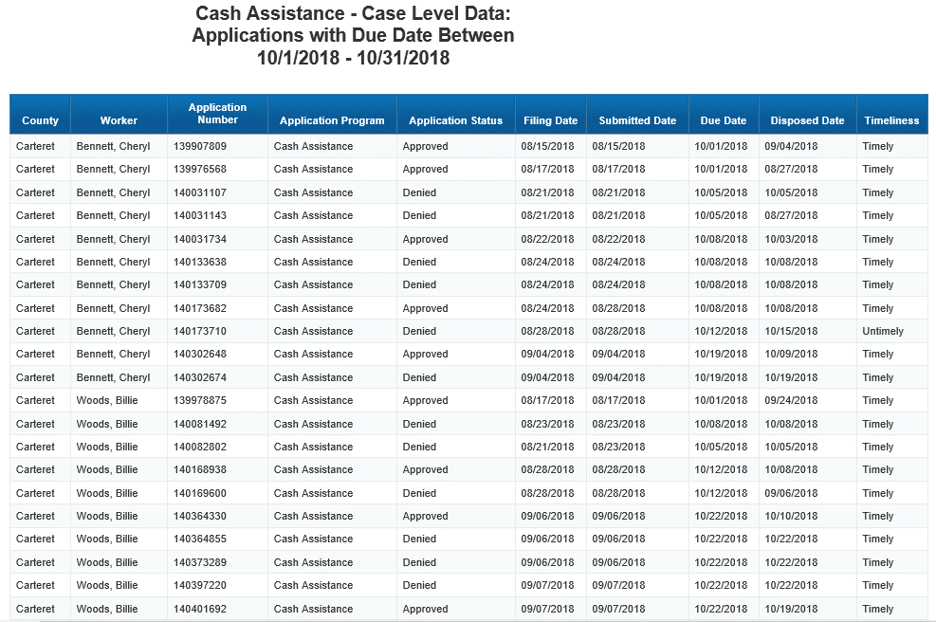
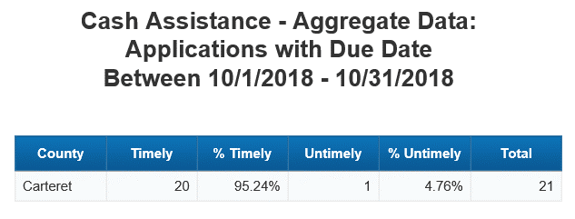
Two Tabs – Detail & Aggregate
TAB 1:
Application Details
TAB 2:
Aggregate Data
Aggregate Report
The aggregate report calculates the percentages.
For the Timely percentage – the numerator is the total number of timely applications divided by the total number of applications. (20/21)
For the Untimely percentage – the numerator is the total number of Untimely applications divided by the total number of applications. (1/21)
Detail Report
Shows all applications with a due date in October that have been disposed.
They may have been disposed in a month prior to October, but the query is looking at all the ones that were due in October and determining if they were processed on time.
If they were disposed on or before the due date, they are timely.
If they were disposed after the due date they are untimely.

Slide 57
WF4: The County will process 95% Work First recertifications no later than the last day of the current recertification period.
EFS DSS Administrative Letter No. 8-2018 Work First Program
Total number of timely WF recertifications processed timely
Total number of WF recertifications

Slide 58
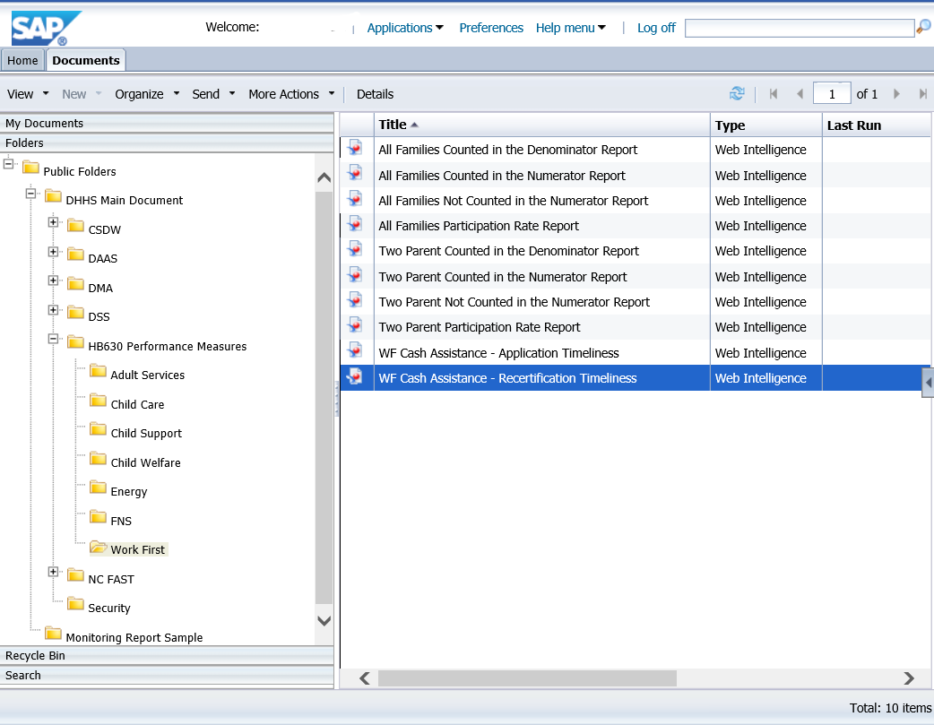
Folders>Public Folders>DHHS Main Document>HB630 Performance Measures>Work First
REPORT NAME: WF Cash Assistance – Recertification Timeliness

Slide 59
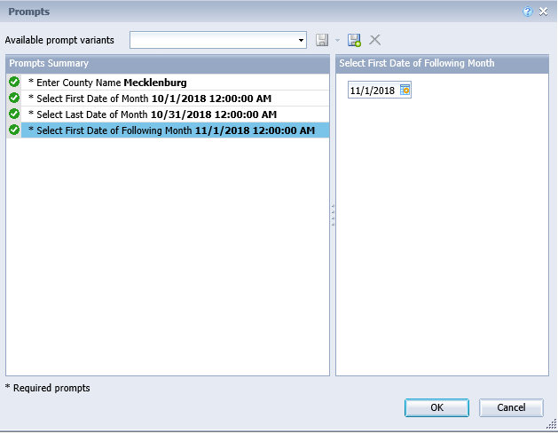
After clicking the report to run, a prompt box comes up.
You may need to “Refresh Values” to see a list of available selections.

Slide 60
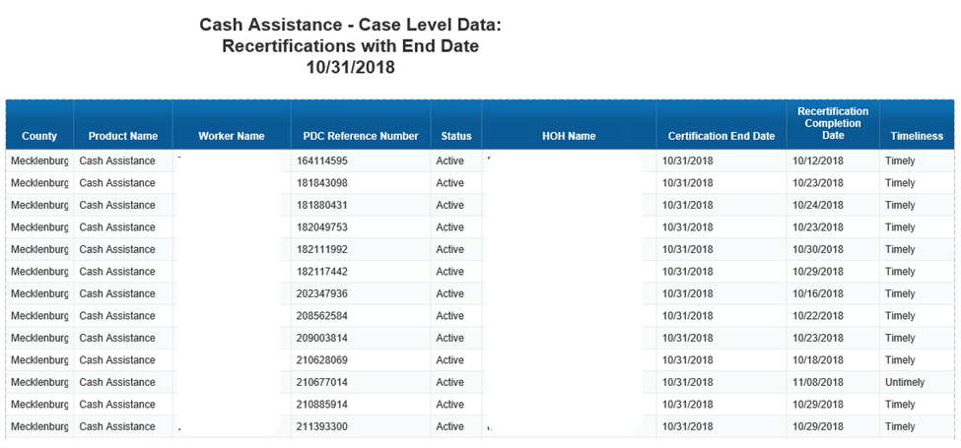
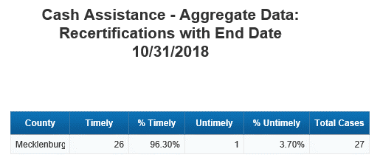
Two Tabs – Detail & Aggregate
TAB 1:
Application Details
TAB 2:
Aggregate Data
Aggregate Report
The aggregate report calculates the percentages.
For the Timely percentage – the numerator is the total number of timely recertifications divided by the total number of recertifications. (26/27)
For the Untimely percentage – the numerator is the total number of Untimely recertifications divided by the total number of recertifications. (1/27)
Detail Report
Shows all recertifications with a due date in October that have been disposed.
If they were disposed on or before the due date, they are timely.
If they were disposed after the due date they are untimely.

Slide 61
QUESTIONS
If there are additional questions about the Work First performance measures, please contact the designated regional OST representative for your county.

Slide 62
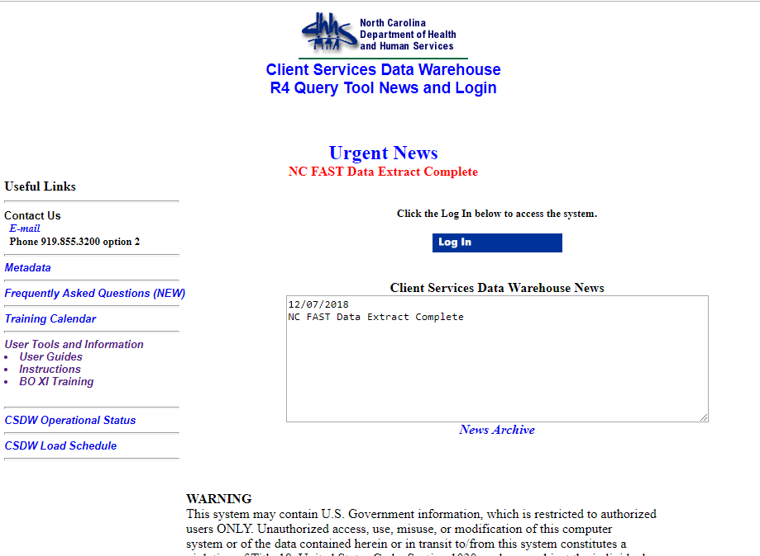
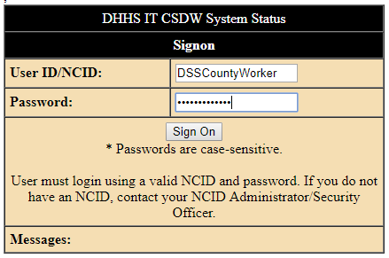
Where to find materials from today’s presentation
Step 2: Login using your NCID
Step 1: Click Here

Slide 63
